Slide 1
Breakthroughs In LLMS : Multimodal Capabilities And Cross Domain Learning

Slide 2
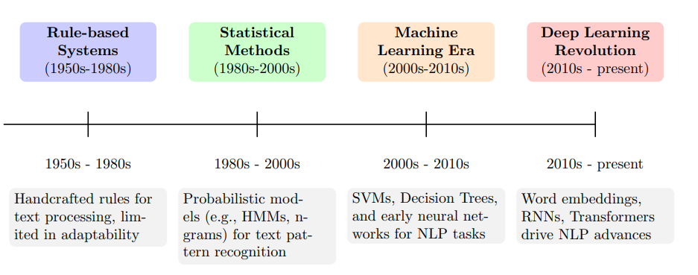
Time line

Slide 3
LLM
Recent years have seen major progress in large language models (LLMs).
Scaling model size and data leads to emergent abilities such as: in-context learning (ICL) chain-of-thought (CoT) reasoning
LLMs show strong zero-shot and few-shot reasoning across many NLP tasks and real-world applications.
However, LLMs are “blind” because they process only text and cannot understand visual information.

Slide 4
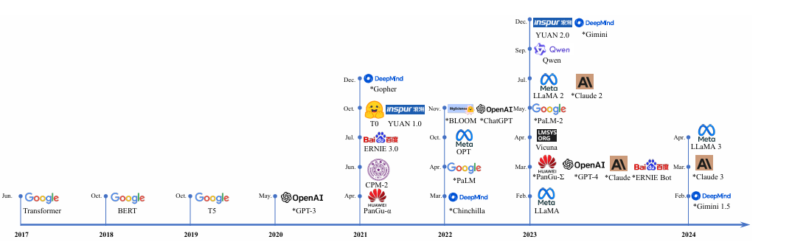
Timeline of pretrained and fine-tuned LLM releases

Slide 5
What Are MLLMs?
MLLMs are LLM-based models that can receive, interpret, and generate multimodal information such as text + images.
Earlier multimodal work includes: • Discriminative models (e.g., CLIP) that map images and text to a shared embedding space. • Generative models (e.g., OFA) that unify multimodal tasks in a sequence-to-sequence format.

Slide 6
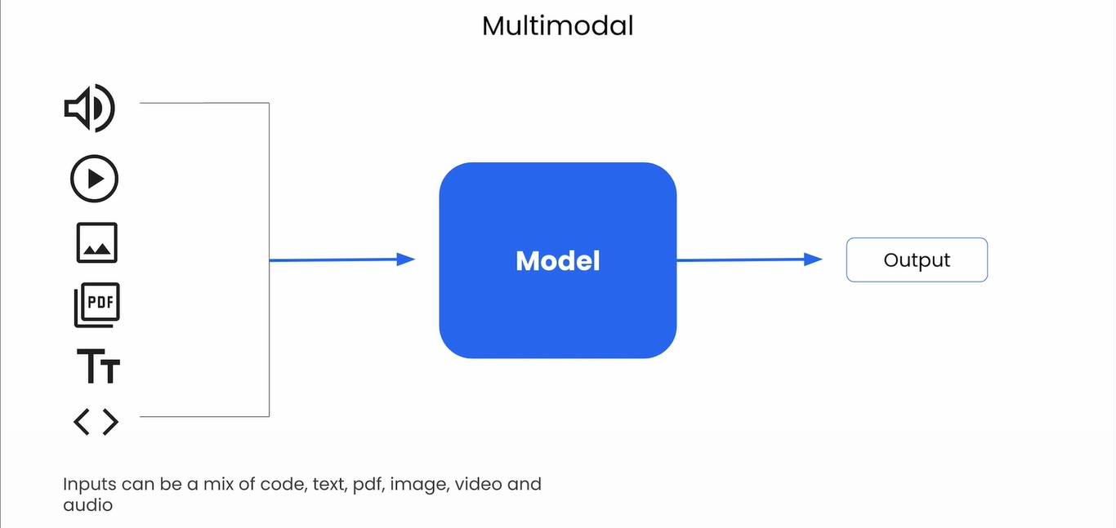

Slide 7
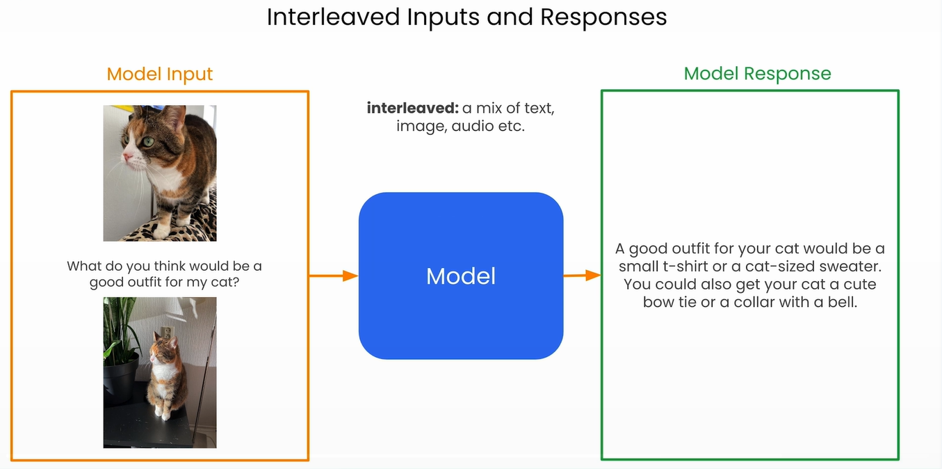

Slide 8
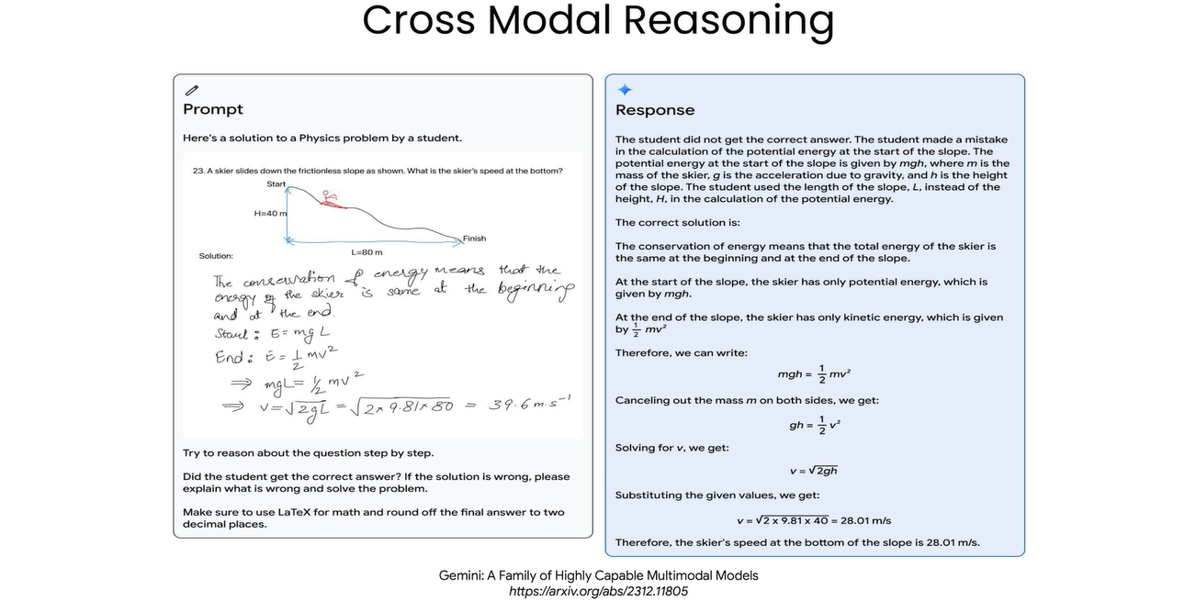

Slide 9
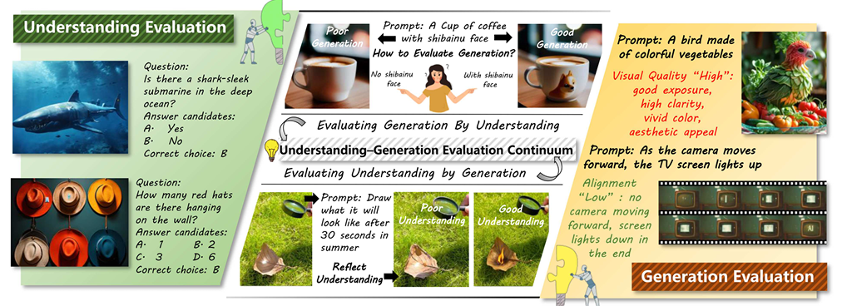

Slide 10
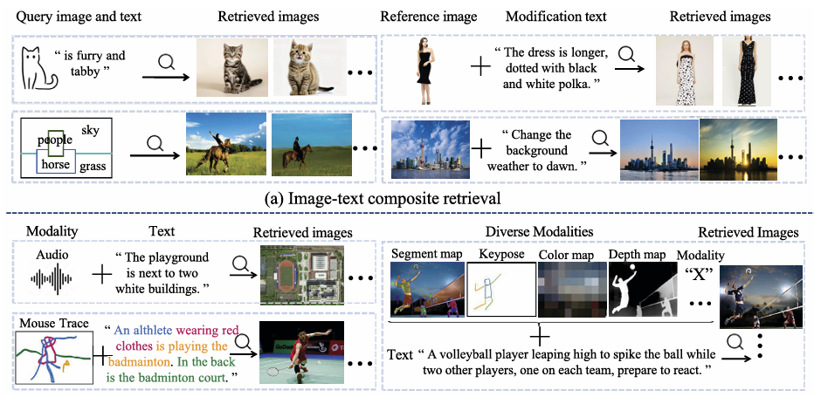
Multimodal

Slide 11
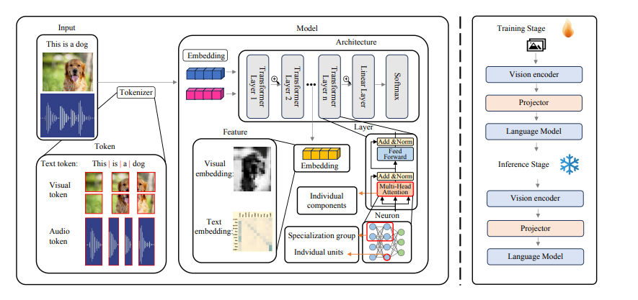
Multimodal

Slide 12
Multimodal Embedding
One of the key features of MLLMs is their ability to embed both text and visual information into a unified space. This allows the model to reason about both modalities in a consistent manner, ensuring that relationships between visual and textual data can be leveraged effectively.
Modality-Specific Encoding: Initially, each input modality is processed through specialized encoders. For textual data, this often involves tokenization followed by embedding through techniques like word2vec or more advanced contextual embedding methods. Visual data is typically encoded using convolutional neural networks (CNNs) or Vision Transformers (ViT) to extract salient features.

Slide 13
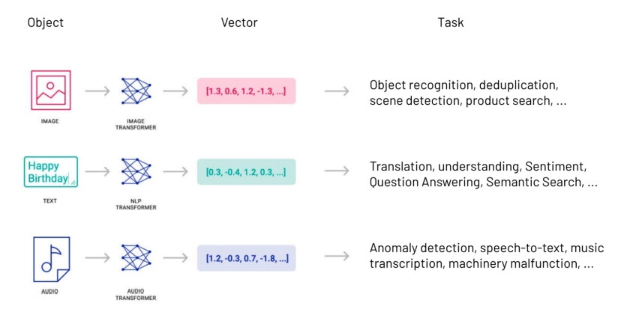
Multimodal Embeddings
Ref: https://www.twelvelabs.io/blog/multimodal-embeddings

Slide 14
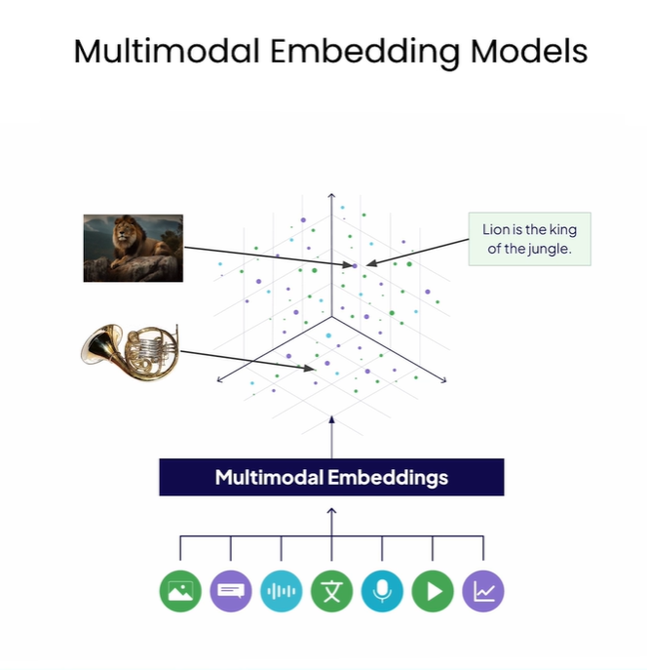

Slide 15
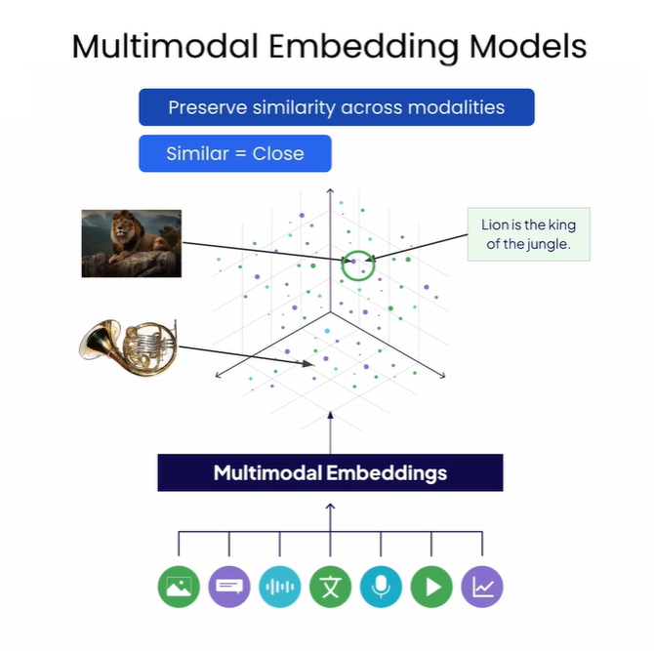

Slide 16
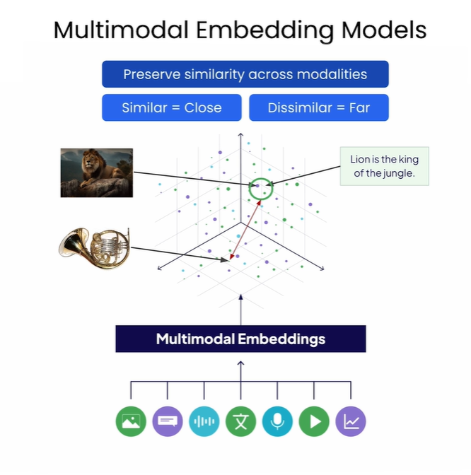

Slide 17
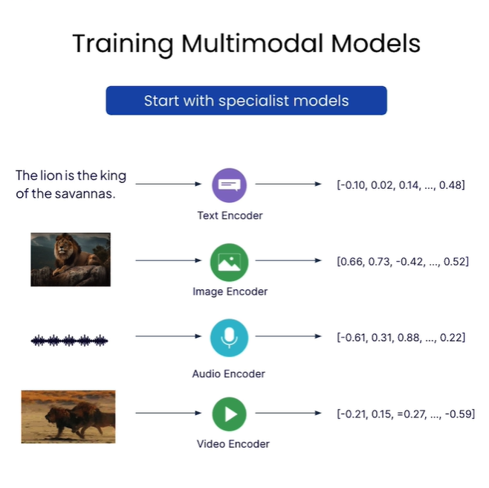

Slide 18
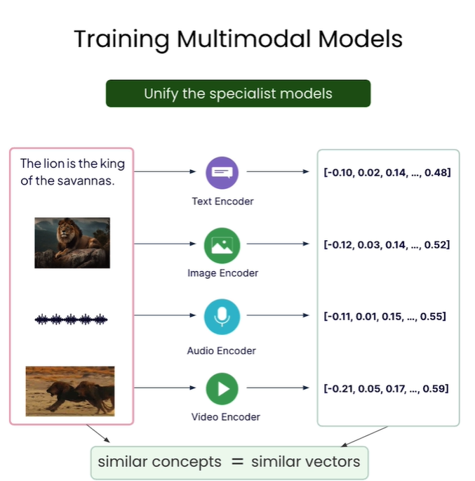

Slide 19
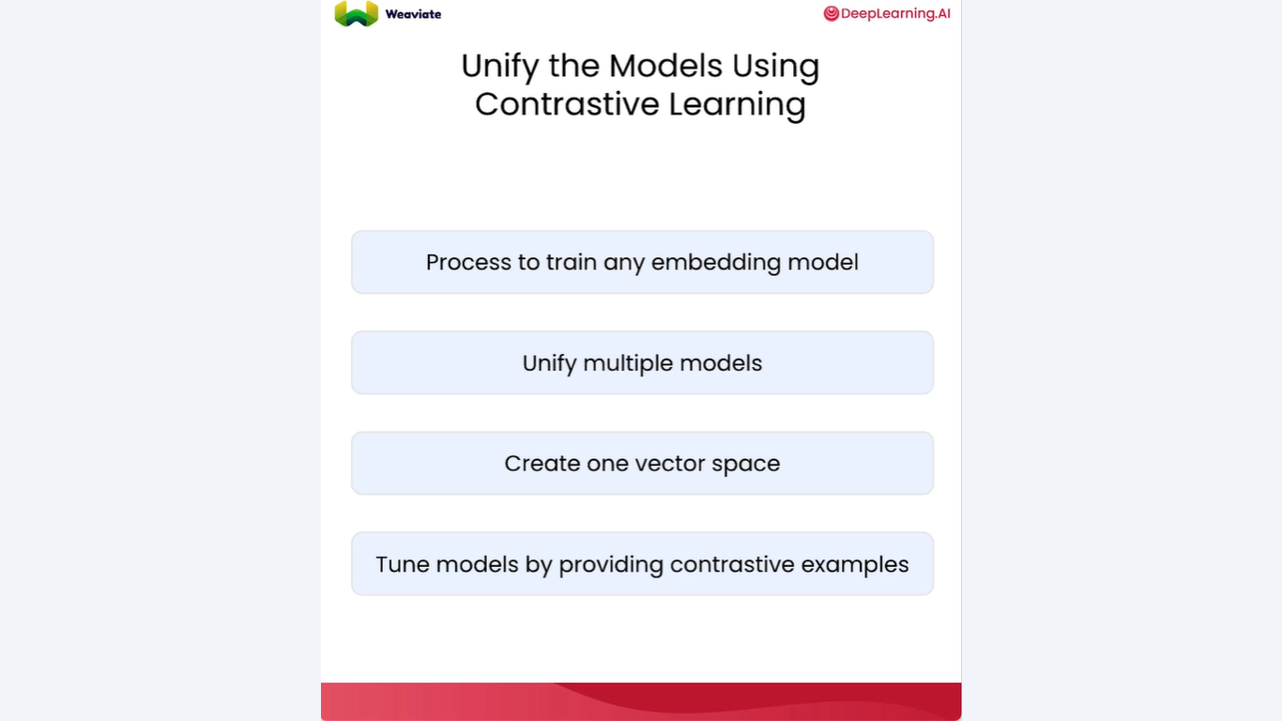

Slide 20
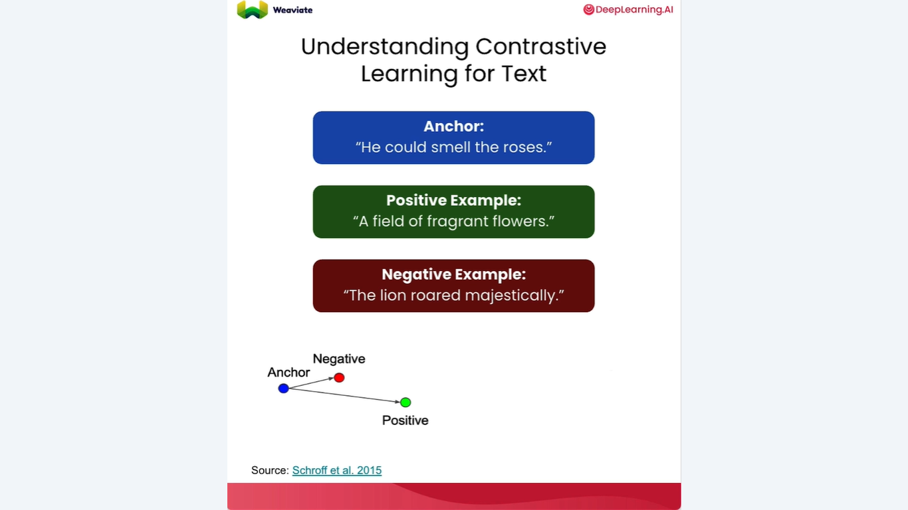

Slide 21
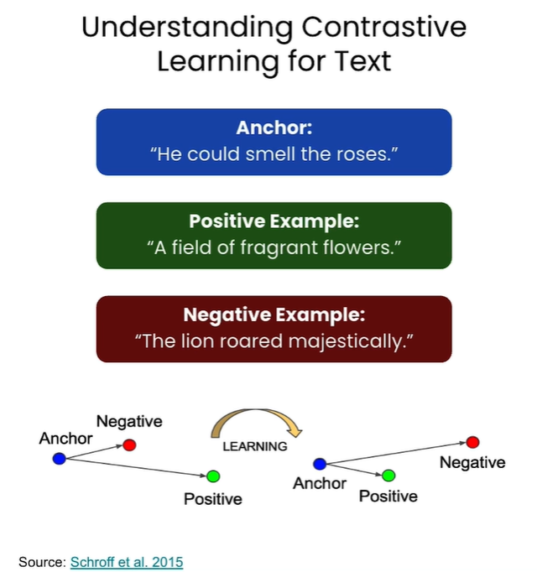

Slide 22
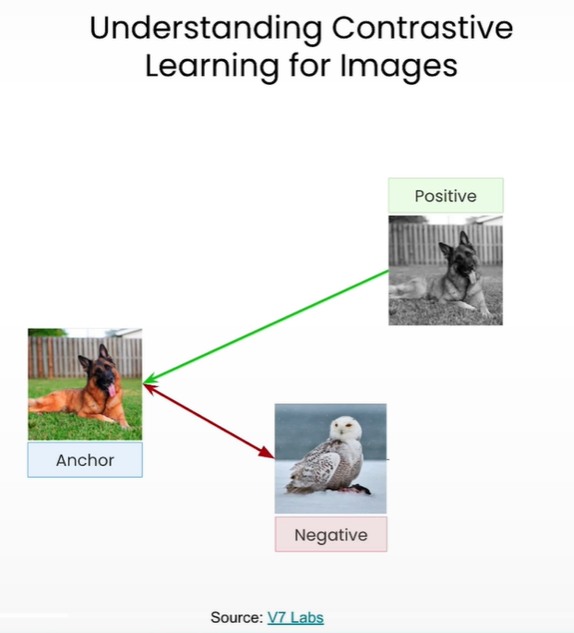

Slide 23
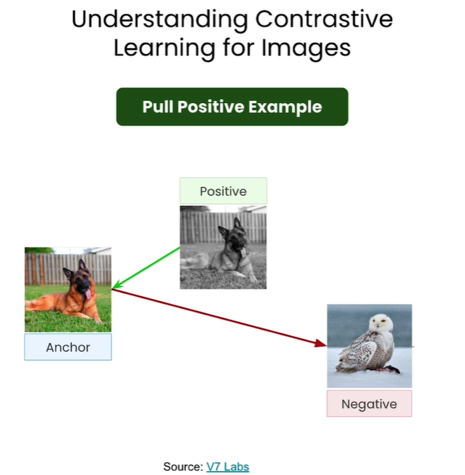

Slide 24
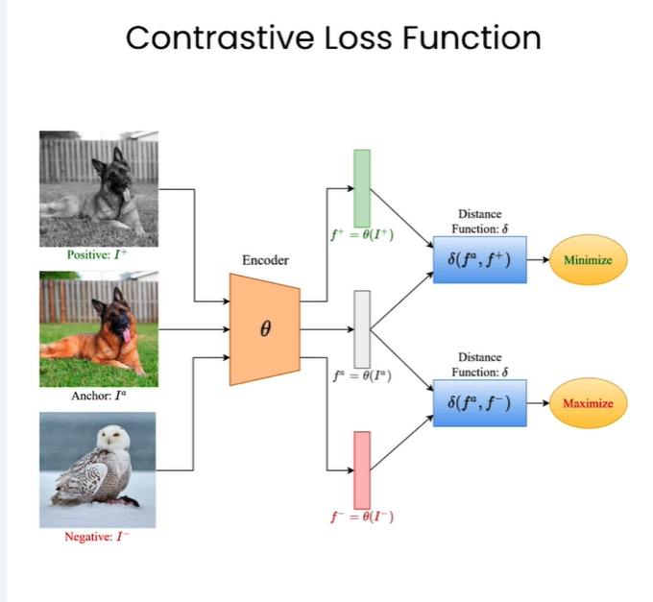

Slide 25
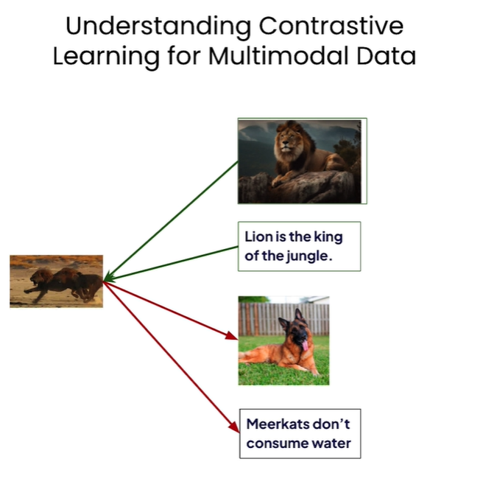

Slide 26
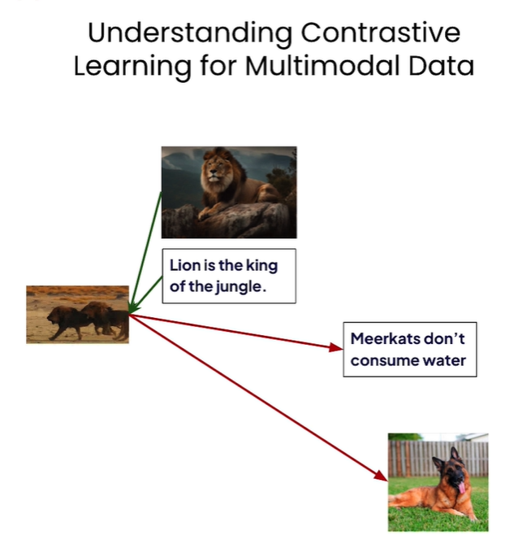

Slide 27
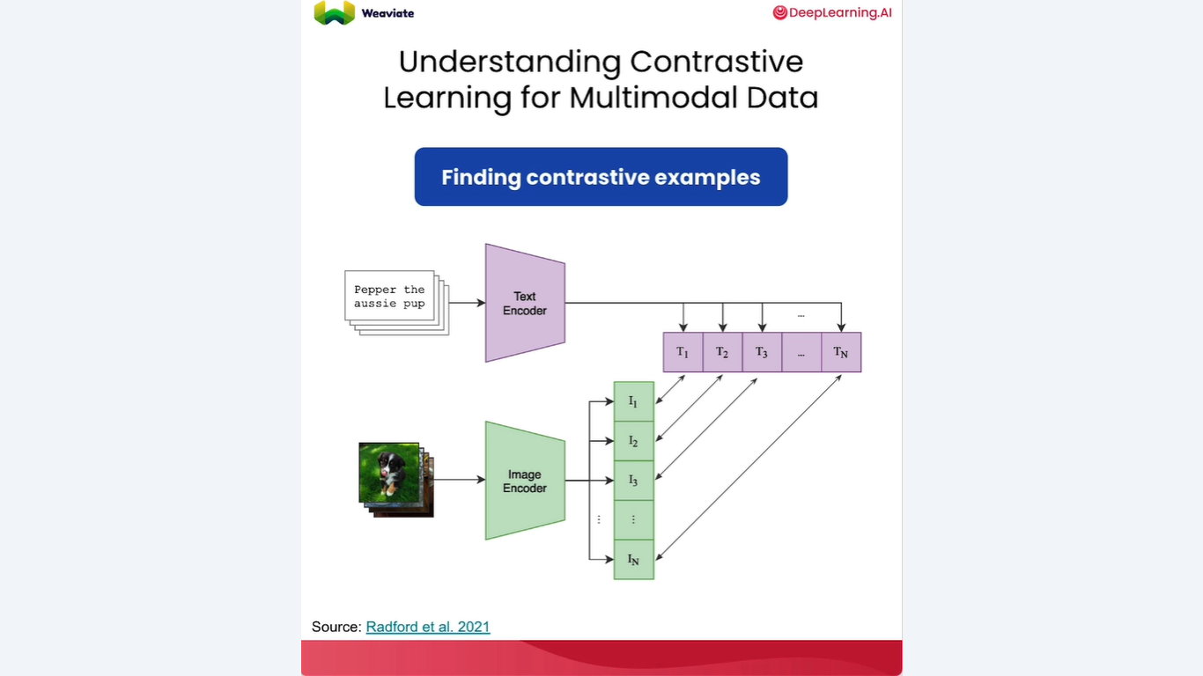

Slide 28
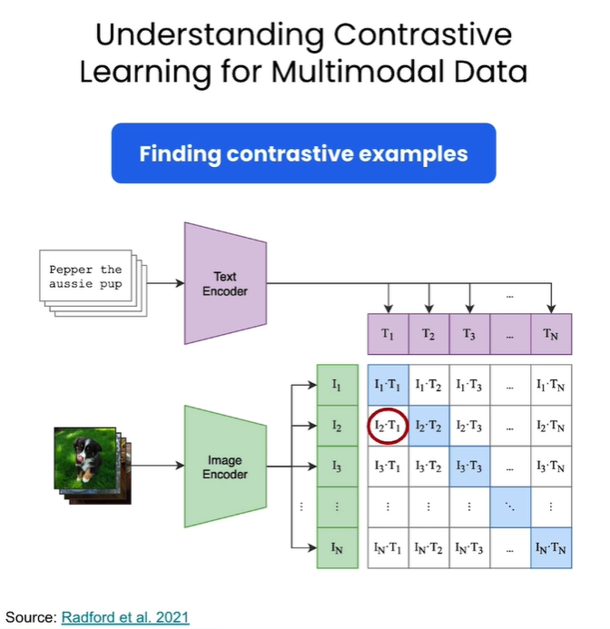

Slide 29
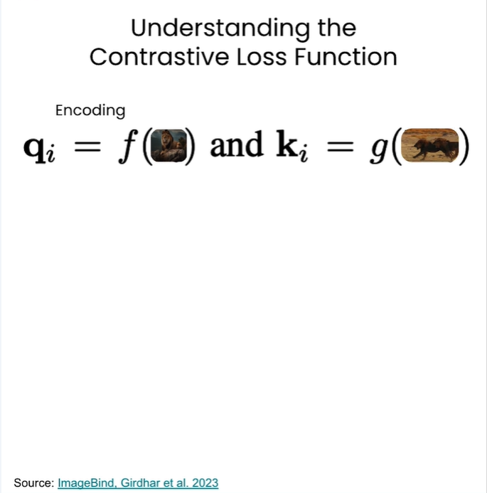

Slide 30
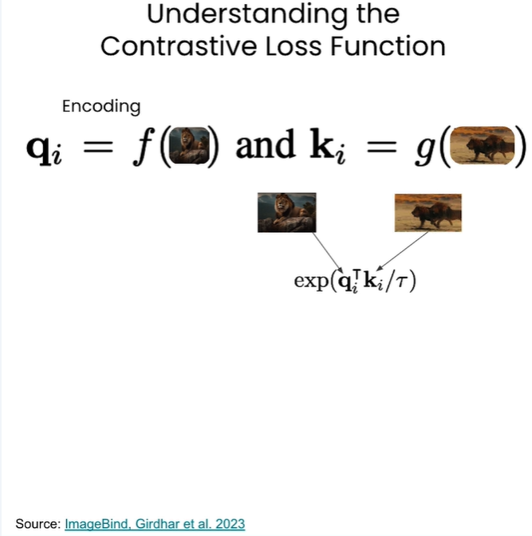

Slide 31
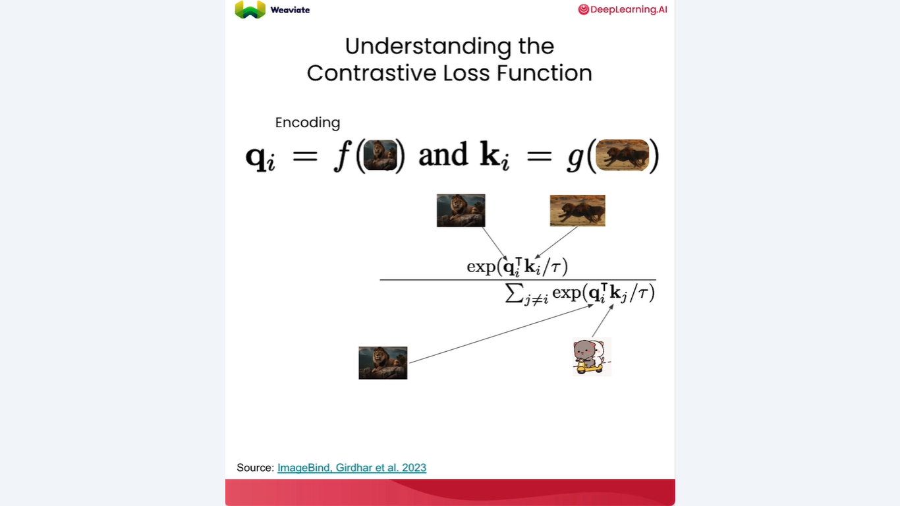

Slide 32
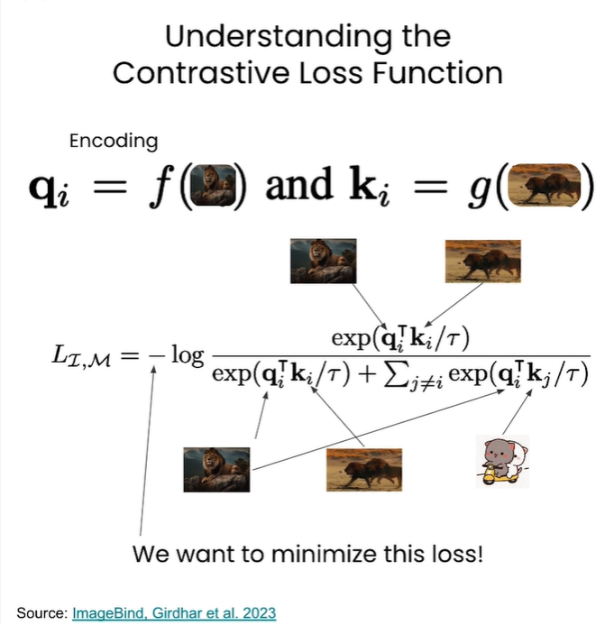

Slide 33
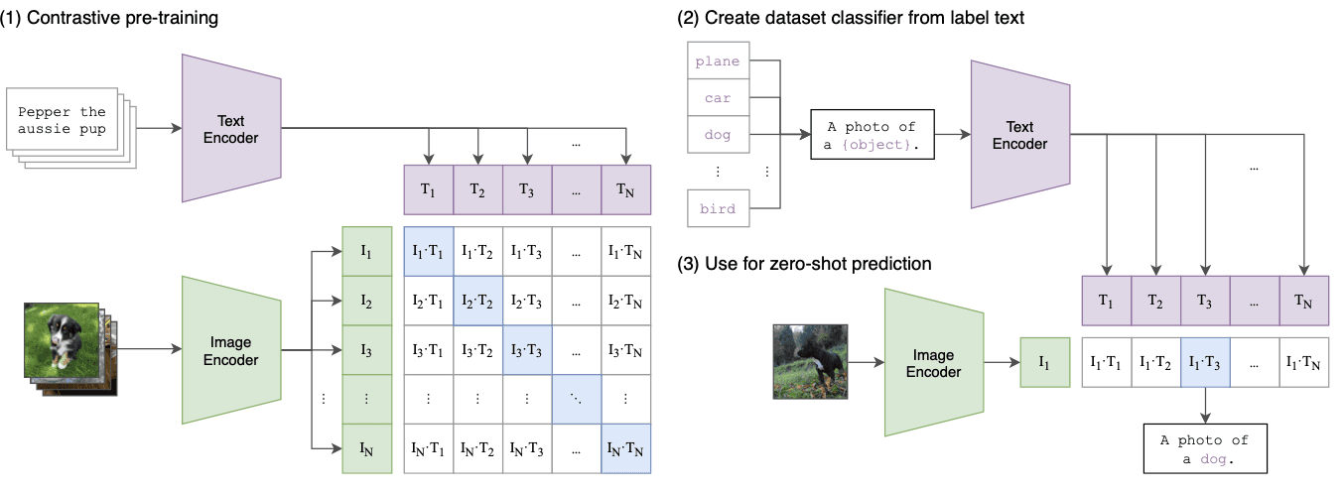
Multimodal Pre-Training

Slide 34
Video Tokenization Techniques
Tokenization is the process of breaking down a video into smaller units called tokens, which can be used as input to a Transformer model. Here are some common tokenization techniques for videos:
Image-based embedding
Audio-based embedding
Joint audio-visual embedding
Temporal embedding
Spatial embedding

Slide 35
Role of Positional Embeddings
Self-attention is the essential operation of the Transformer. It enhances each token embedding with information from other embeddings in a sequence It is crucial to indicate positional information to utilize the spatiotemporal structure of videos. This is achieved using positional embeddings (PE), which encode the temporal position information of video frames or clips within the Transformer.
Learned positional embedding
Fixed positional encoding
Relative positional encoding
Hybrid approaches
Embeddings In Production

Slide 36
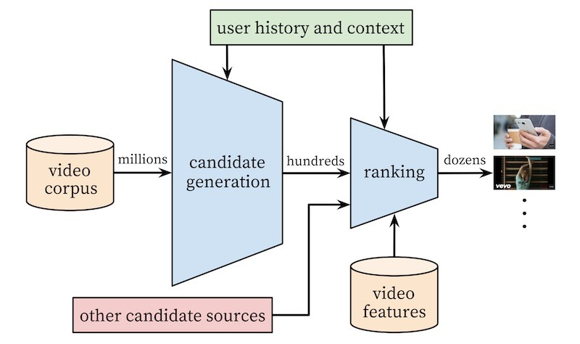
Embeddings In Production
As YouTube has over 800 million pieces of content (videos) and 2.6 billion active users, the application needs to recommend existing content to users while also being able to generalize to new content, which is frequently uploaded.
These recommendations need to be served quickly at inference time—when the user loads a new page—with low latency.

Slide 37
Embeddings In Production
Embeddings that represent the user and their context as features, and
Embeddings that represent the video items. The model has many features, including ones based on tables and embeddings. The embeddings-based features include:
User watch history - a vector that shows which videos the user has watched, represented as a sparse video ID mapped to a dense vector.
User's search history - shows which videos the user clicked on after a search term. This is also represented as a sparse vector mapped to the same space as the user watch history.
User's geography, age, and gender - shown as table features.
The number of previous impressions a video had, normalized per user over time

Slide 38
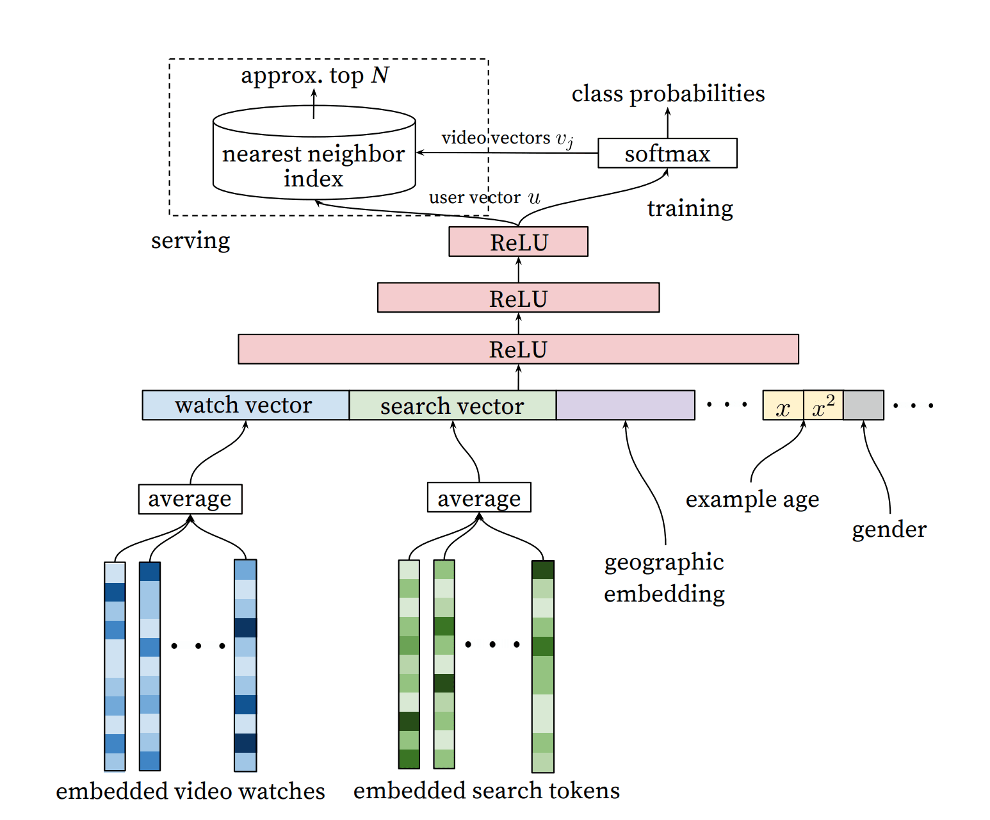
Embeddings In Production

Slide 39
Multimodal Embedding
One of the key features of MLLMs is their ability to embed both text and visual information into a unified space.
This technique involves projecting data from different modalities—primarily text and images in the context of MLLMs—into a shared, high-dimensional vector space.
The resulting embeddings capture semantic relationships not only within each modality but also across modalities, facilitating more sophisticated cross-modal reasoning and analysis.

Slide 40
Multimodal Embedding
Modality-Speific Encoding
Dimensionality Alignment
Joint Representation Learning:
Contrastive Learning:Many state-of-the-art MLLMs employ contrastive learning. Produce similar embeddings for semantically related text-image pairs while pushing apart unrelated pairs in the embedding space.
Fine-tuning for Downstream Tasks

Slide 41
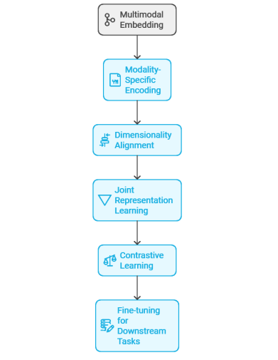
Multimodal Embedding

Slide 42
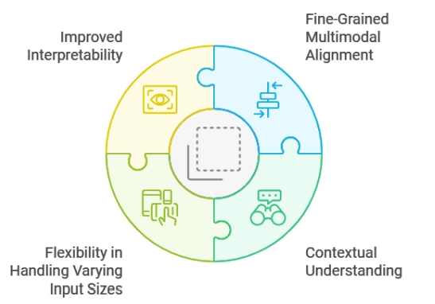
Cross-Attention Layers
These layers enable the model to dynamically focus on relevant aspects of one modality while processing information from the other, thereby enhancing the model’s capacity to understand and reason about multimodal inputs.
The mechanism of cross-attention is derived from the self-attention concept introduced in the Transformer architecture. However, unlike self-attention, which operates within a single modality, cross-attention allows the model to attend to information across different modalities.

Slide 43
CLIP
In 2021, CLIP was proposed as a new milestone. It uses multimodal pre-training to convert classification into a retrieval task, which enables pre-trained models to tackle zero-shot recognition. Thus, CLIP is a successful practice that fully utilizes large-scale multimodal pre-training to enable zero-shot learning. This has become a main breakthrough for many multimodal tasks.
CLIP stands for Contrastive Language–Image Pretraining, a groundbreaking model developed by OpenAI. It’s a multimodal neural network — meaning it understands both images and text — and can connect the two in meaningful ways.
Vision Encoder (ViT or ResNet): Converts images into embeddings using a Vision Transformer or convolutional backbone.
Text Encoder (Transformer): Converts text into embeddings (like a small BERT).
It uses a contrastive learning objective on a massive dataset of image–caption pairs (around 400 million pairs).
Training goal: Pull the embeddings of matching image–text pairs closer together and push non-matching pairs further apart.
https://github.com/openai/CLIP

Slide 44
Vision Encoders and Language Decoders
Vision Transformers (ViT):An image is divided into fixed-size patches, which are linearly embedded and treated as a sequence of tokens.
Language decoders in multimodal large language models (MLLMs) generate contextually grounded text by leveraging transformer-based architectures with self-attention and cross-attention mechanisms. Operating autoregressively, they produce tokens sequentially, attending both to prior outputs and to visual embeddings from the vision encoder. This enables cross-modal tasks such as image captioning and visual question answering.

Slide 45
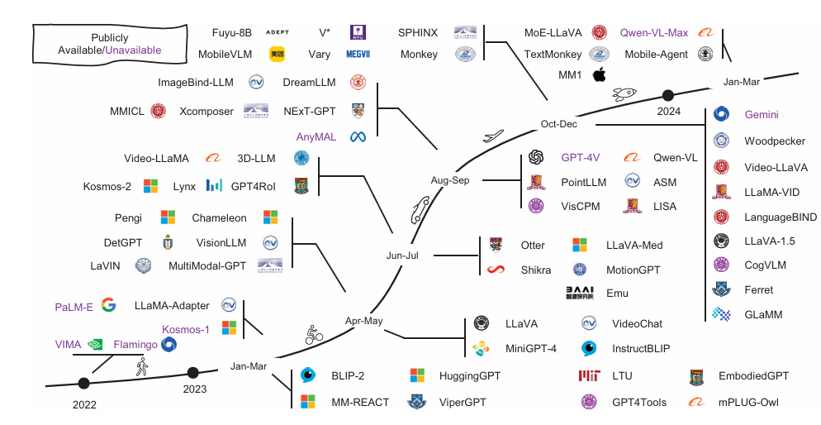
. A timeline of representative MLLMs

Slide 46
Training Methodologies and Data Requirements
Contrastive learning :This approach enables the development of a nuanced understanding of the relationship between visual and textual modalities.
Masked language modeling, adapted from text-only models, involves randomly masking tokens in the input text and training the model to predict these masked tokens.
In the multimodal context, this technique is extended to incorporate visual information, allowing the model to leverage visual cues in predicting masked textual content. Additionally, image-text matching tasks encourage the model to develop a holistic understanding of both modalities and their interrelations

Slide 47
Training Methodologies and Data Requirements
MLLMs undergo fine-tuning to adapt to specific downstream tasks. This process involves several considerations, including task-specific adaptation tailored to the requirements of the target task.
Fine-tuning for visual question answering may involve training the model on question-answer pairs associated with images, while image captioning fine-tuning focuses on generating descriptive text for given images.
CLIP model was trained on a dataset of 400 million image-text pairs, while more recent models have utilized even larger datasets.
The accuracy of image-text alignments in the training data is paramount. Misaligned pairs can introduce noise into the training process

Slide 48
Pretraining on Multimodal Data
MLLMs are often pretrained on large-scale multimodal datasets that include aligned pairs of text and images. This allows the model to learn correlations between words and visual features, a crucial aspect for downstream tasks.
Pretraining process typically employs several key strategies:
Contrastive Learning: distinguish between related and unrelated image-text pairs
Masked Language Modeling (MLM): masking tokens in the input text and training the model to predict these masked tokens. this technique is extended to incorporate visual information

Slide 49
Pretraining on Multimodal Data
Masked Image Modeling (MIM):masking portions of the input image and training the model to reconstruct or predict the masked regions.
Image-Text Matching: model is trained to determine whether a given image-text pair
Visual Grounding:training the model to locate specific objects or regions in an image based on textual descriptions.
Datasets: Conceptual Captions, LAION-5B, or JFT-300M

Slide 50
Contrastive Learning (CLIP, ALIGN)
Basic Concept: Contrastive learning aligns matching and non-matching text–image pairs to build a shared embedding space for effective cross-modal retrieval.
Hallucination Augmented Contrastive Learning: Generates synthetic data to strengthen contrastive learning, improving robustness and zero-shot generalization.
Img-Diff: Contrastive Data Synthesis: Creates new multimodal samples (e.g., Img-Diff dataset) to enhance data quality for high-performance
MLLM training. Integration with Other Techniques: Combines contrastive learning with tasks like masked language modeling and visual question answering for stronger multimodal understanding.

Slide 51
Contrastive Learning (CLIP, ALIGN)
CLIP, developed by OpenAI, uses contrastive learning to link images with matching text and separate mismatched pairs, enabling strong zero-shot recognition without task-specific training.
ALIGN, by Google, learns joint image–text embeddings from large, noisy datasets, maintaining scalability and noise robustness while achieving powerful zero-shot results. Both models showcase contrastive learning’s ability to unify vision and language through shared embedding spaces.

Slide 52
Masked Language Modeling (MLM) in Multimodal Large Language Model
Masked Language Modeling (MLM) trains models to predict missing words from context, and in Multimodal Large Language Models (MLLMs), it extends to predicting both masked words and image regions for joint visual–text understanding.
MLLMs using MLM power tasks like object-centric robotic manipulation, where models infer actions from combined text and vision.
Training typically blends contrastive learning, image–text matching, and MLM, enhancing cross-modal alignment for tasks such as image captioning and visual question answering.
Current research focuses on improving efficiency, architectural design, and dataset diversity to create more capable and resource-efficient multimodal systems.

Slide 53
Visual Question Answering (VQA)
Visual Question Answering (VQA) is a key multimodal task where models learn to interpret and reason over paired images and questions using cross-attention mechanisms for effective visual–text alignment.
Advanced VQA systems, especially in domains like medical imaging, integrate unimodal and multimodal contrastive losses and retrieval-augmented methods to capture richer context.
Despite progress, challenges persist due to limited domain-specific multimodal data, prompting the use of data augmentation and transfer learning to enhance robustness.
Current research aims to refine pre-training techniques and expand dataset diversity for greater accuracy and adaptability across applications.

Slide 54
Vision-and-Language Pretraining (VLP)
Models like UNITER, ViLBERT, and OSCAR are prime examples of this multitask approach, which enhances multimodal reasoning by integrating cross-modal fusions within a dual-encoder architecture.
VLP strategies have addressed challenges related to heterogeneity in federated learning environments, particularly in specialized domains such as biomedical applications. These improvements have been instrumental in refining the flexibility and adaptability of VLP models, making them more efficient in handling diverse datasets and tasks

Slide 55
Fine-Tuning for Specific Tasks
After pretraining ,models may be fine-tuned on datasets for image captioning, visual question answering, or cross-modal retrieval.
This process ensures that the model can transfer its learned multimodal representations to practical applications.
Task-Specific Adaptation:
Transfer Learning: fine-tuning for visual question answering (VQA) involves training the model on question-answer pairs associated with images, while image captioning fine-tuning focuses on generating descriptive text for given images.
Transfer Learning
Architectural Modifications
Hyperparameter Optimization
Few-Shot and Zero-Shot Learning

Slide 56
Fine-Tuning for Specific Tasks
Continual Learning: Some fine-tuning approaches focus on enabling the model to learn new tasks without forgetting previously learned information, a challenge known as catastrophic forgetting.
Multi-Task Fine-Tuning: In some cases, models are fine-tuned on multiple related tasks simultaneously, which can lead to improved performance across all tasks due to shared learning.
Domain Adaptation: When the target task involves a domain significantly different from the pretraining data, fine-tuning may include techniques to bridge this domain gap, such as gradual fine-tuning or domain-adversarial training

Slide 57
Fine-Tuning for Specific Tasks
Image captioning, datasets like the Microsoft Common Objects in Context (MS COCO) are extensively used. MS COCO comprises over 330,000 images, each annotated with multiple captions, offering a rich resource for training models to generate descriptive textual representations of visual content.
VQA 2.0 dataset is a prominent resource. It contains over 1.1 million questions based on over 200,000 images, with each question designed to test the model’s ability to comprehend and reason about visual information in conjunction with textual queries.
task-specific datasets are foundational to the fine-tuning of MLLMs

Slide 58
Challenges in Data Curation:
Resource Intensity: Collecting and processing billions of image-text pairs requires substantial computational and human resources.
Annotation Complexity: For tasks requiring fine-grained annotations, such as object detection or segmentation, the annotation process becomes increasingly complex and time-consuming.
Quality Control: Maintaining consistent quality across a large-scale dataset is challenging, often requiring multiple rounds of validation and refinement.
Domain Specificity: For certain applications, general web-scraped datasets may not suffice, necessitating the creation of domain-specific datasets, which can be particularly resource-intensive.

Slide 59
Challenges of Data Alignment
Semantic Coherence: Text must match the image meaning to prevent false learning.
Contextual Relevance: Captions should highlight key context, not just visible objects.
Temporal Consistency: Text and visuals must stay aligned over time in videos.
Cultural & Linguistic Nuance: Cultural or language differences can cause subtle misalignments.
Ambiguity & Subjectivity: Images may have multiple meanings that confuse alignment.
Scale-induced Errors: Larger datasets increase the risk of unnoticed alignment errors.

Slide 60
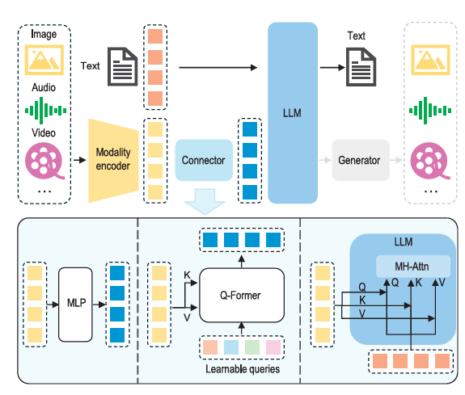
An illustration of typical MLLM architecture.

Slide 61
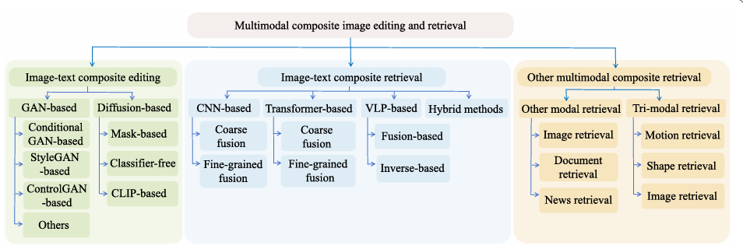

Slide 62
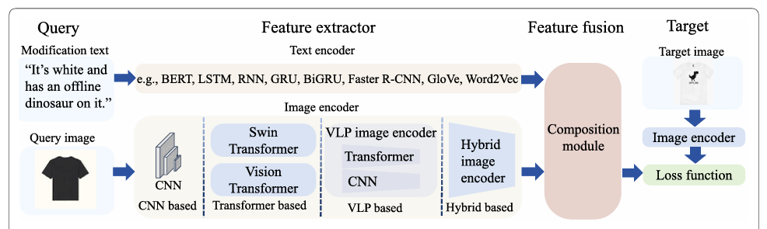
Basic Technical Framework Of Image-text Composite Retrieval

Slide 63
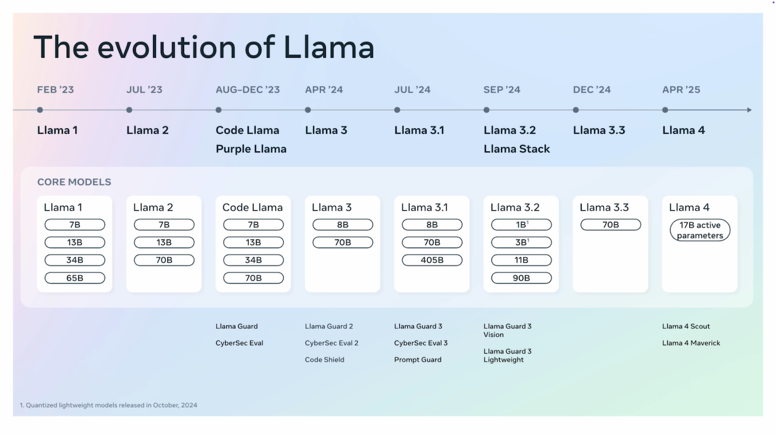

Slide 64
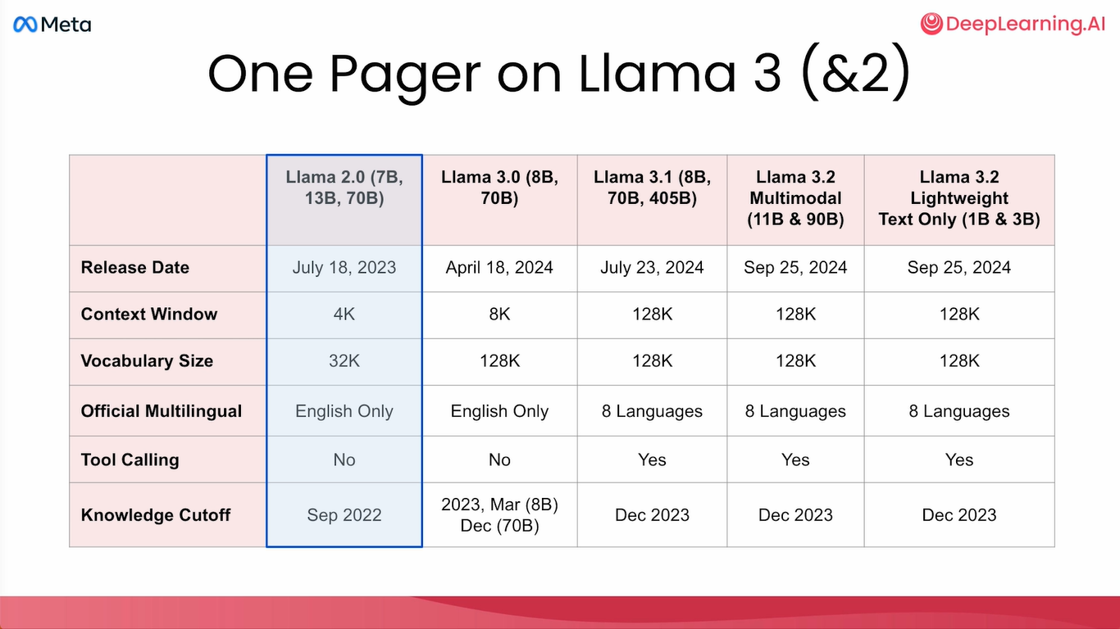

Slide 65
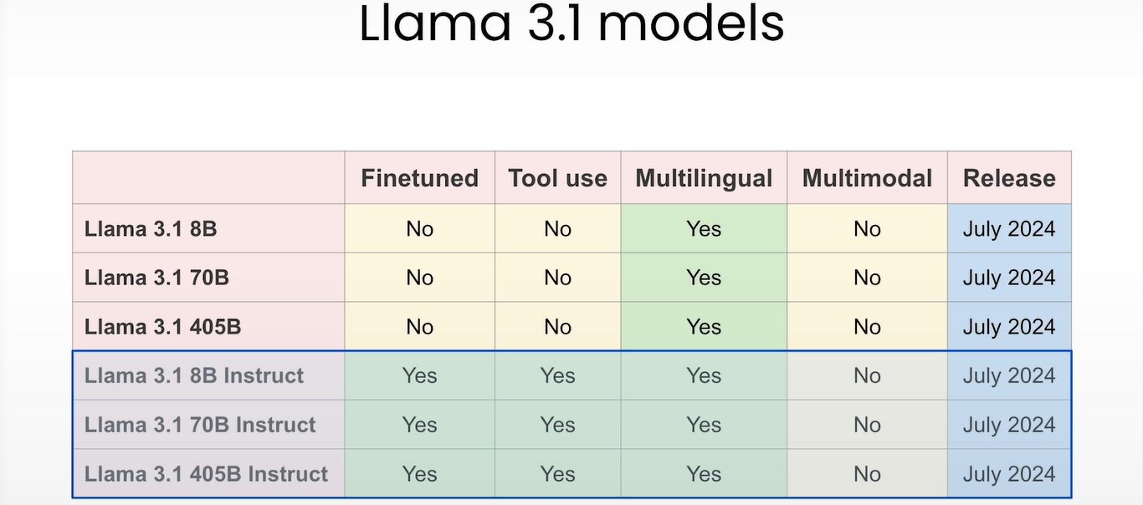

Slide 66
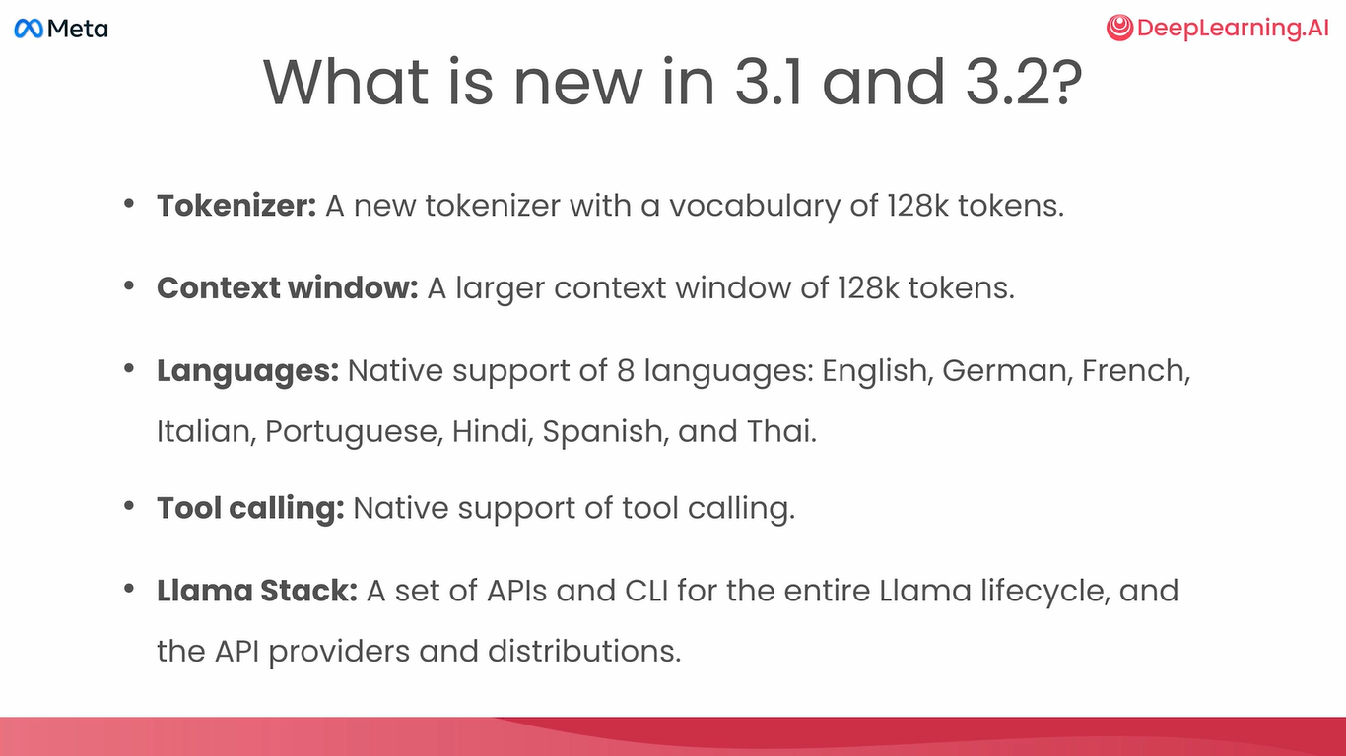

Slide 67
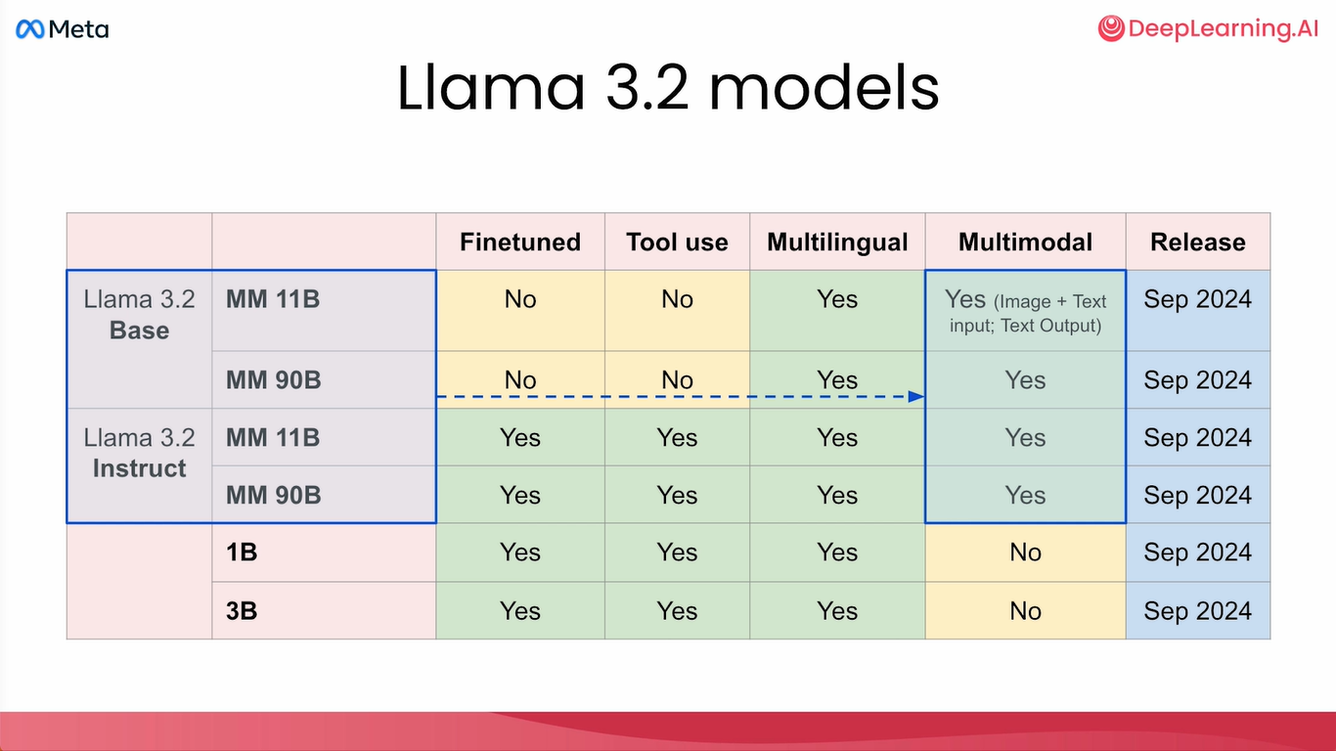

Slide 68
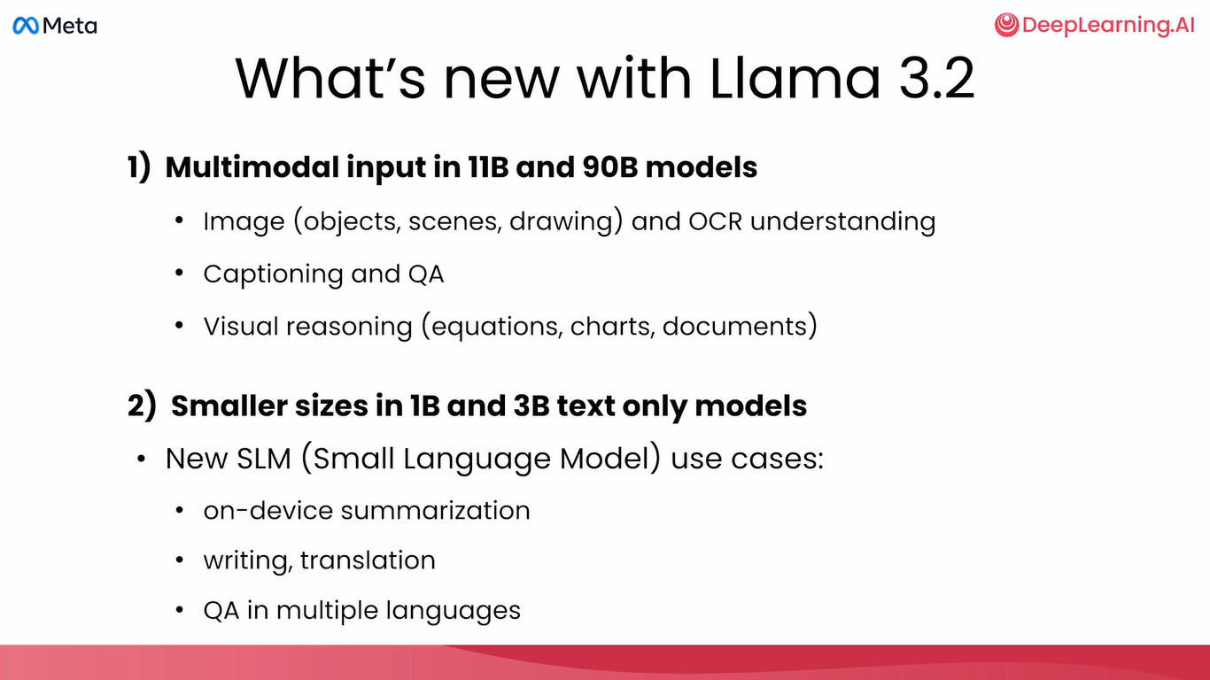

Slide 69
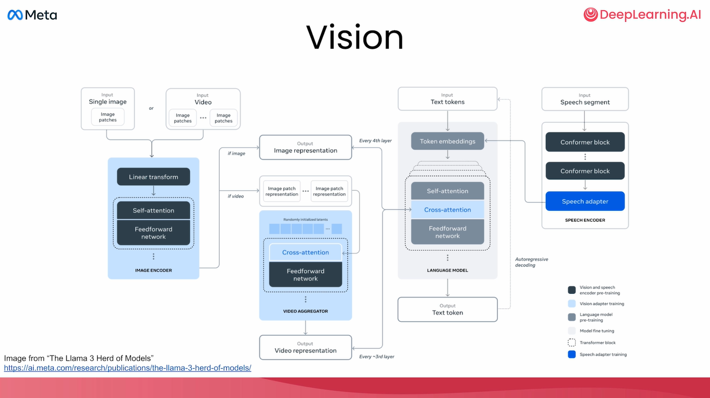

Slide 70
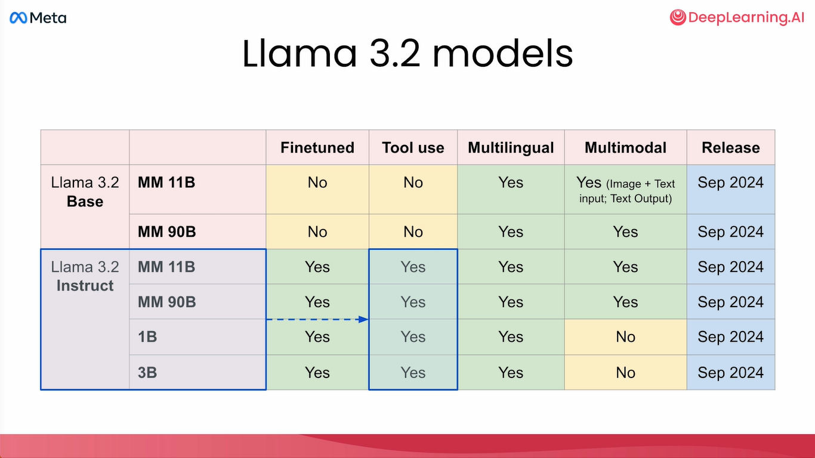

Slide 71
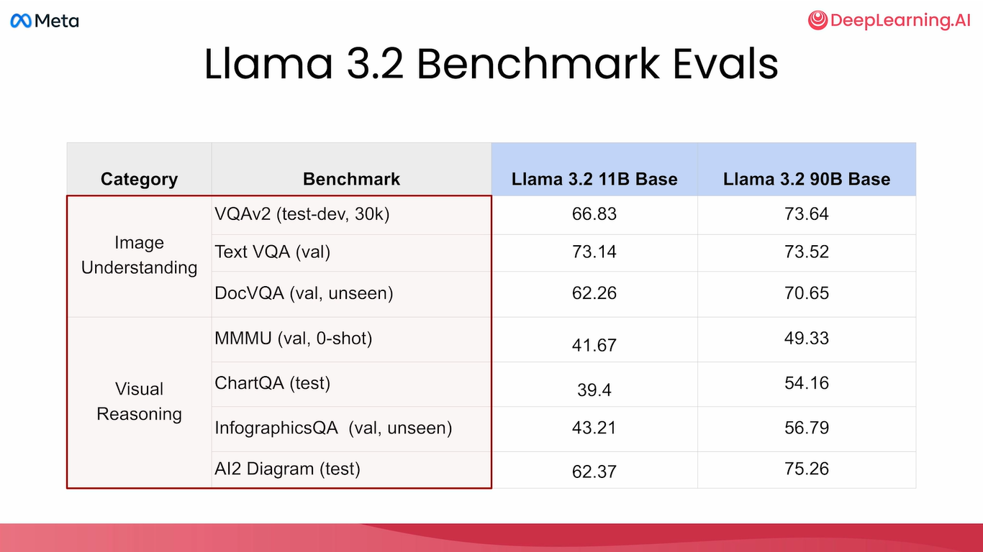

Slide 72
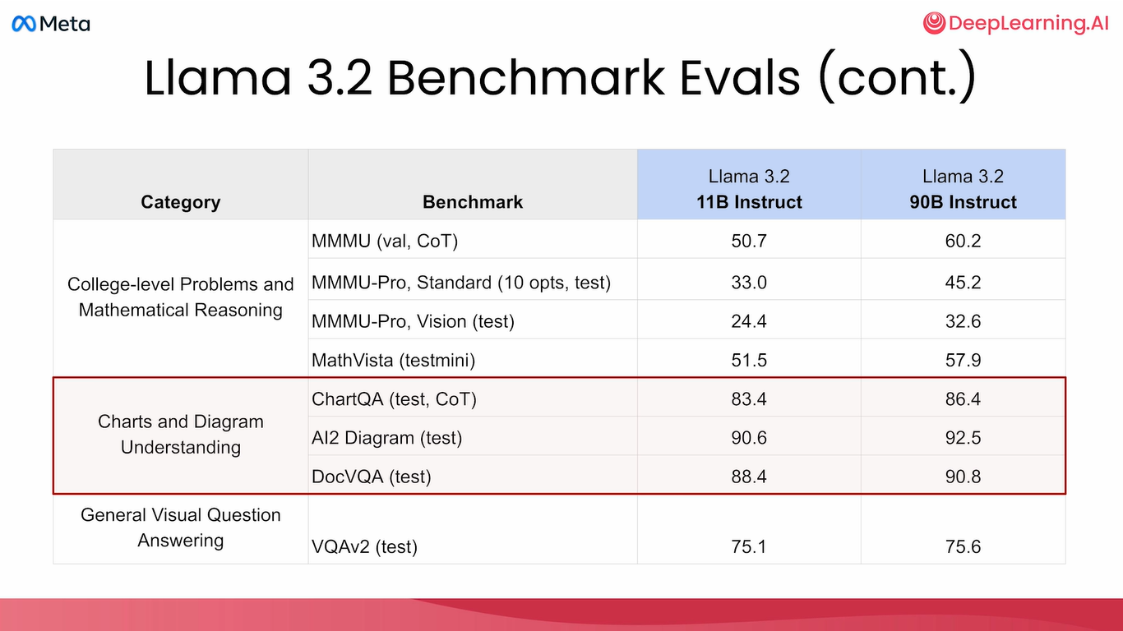

Slide 73
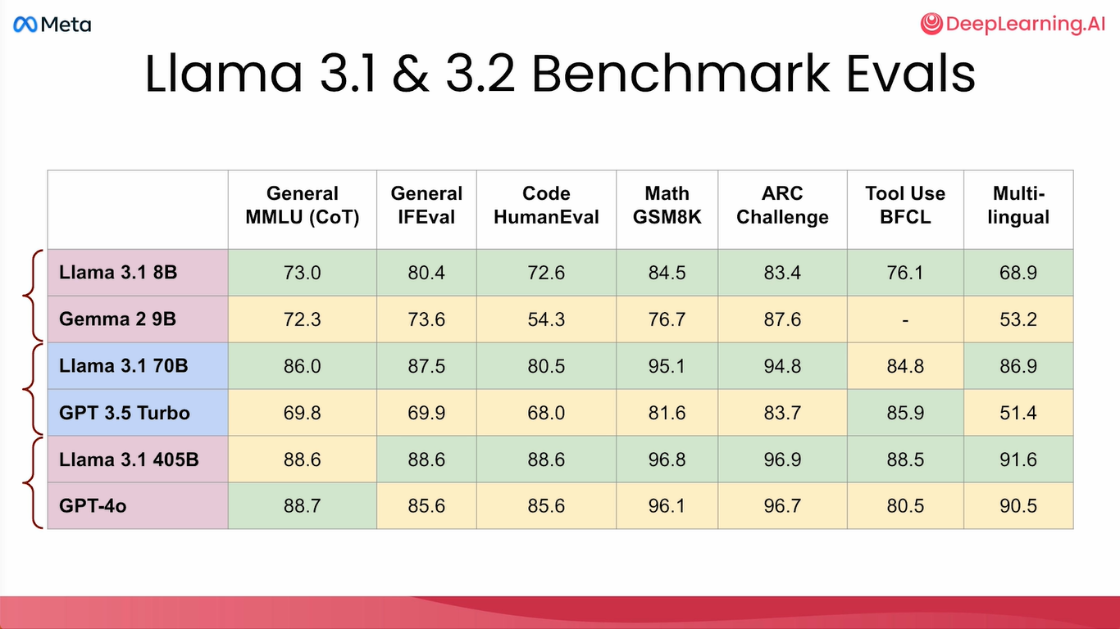

Slide 74
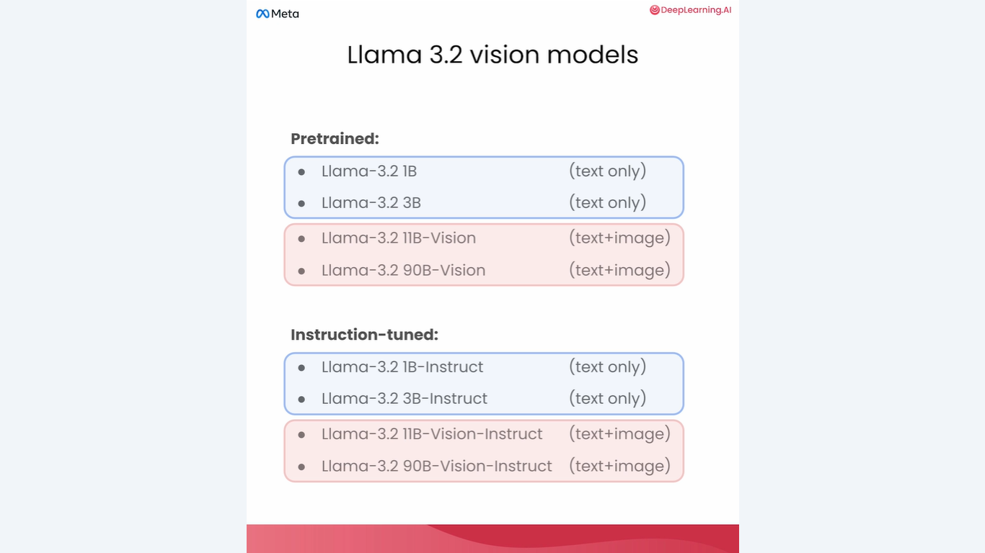

Slide 75
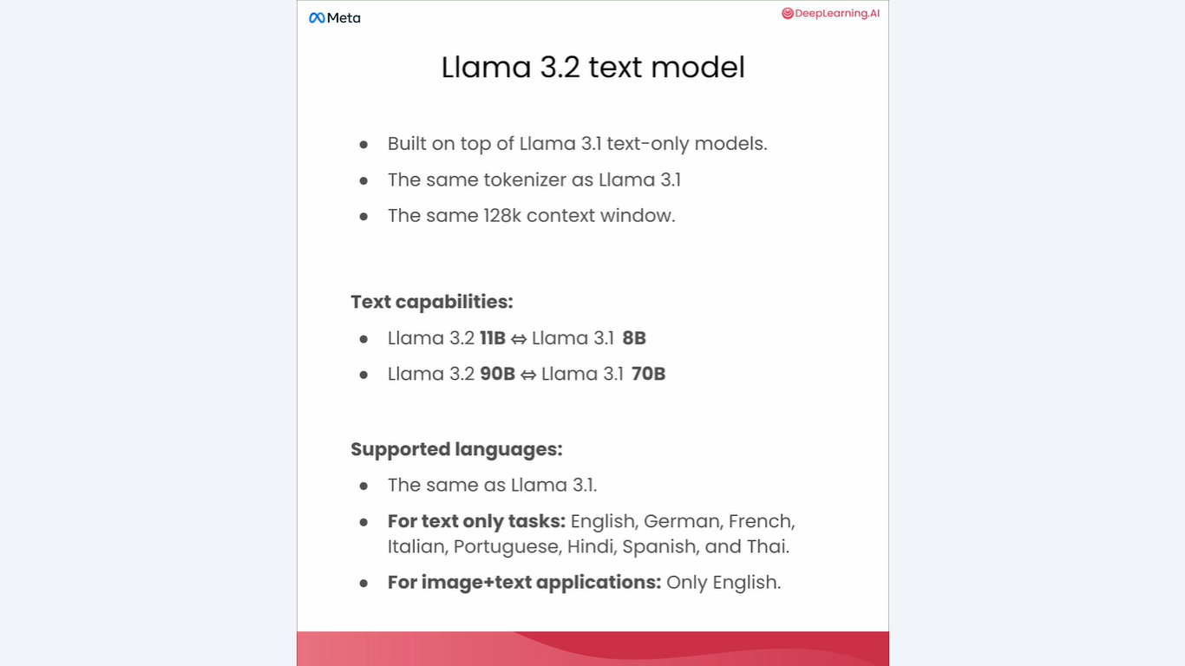

Slide 76


Slide 77


Slide 78


Slide 79


Slide 80


Slide 81


Slide 82


Slide 83


Slide 84


Slide 85


Slide 86


Slide 87


Slide 88


Slide 89


Slide 90


Slide 91


Slide 92


Slide 93


Slide 94


Slide 95


Slide 96


Slide 97


Slide 98


Slide 99


Slide 100


Slide 101


Slide 102


Slide 103


Slide 104


Slide 105


Slide 106


Slide 107


Slide 108


Slide 109


Slide 110


Slide 111


Slide 112


Slide 114
https://github.com/https-deeplearning-ai/sc-gc-c4-gemini-public

